Slide 1

Artificial Intelligence Tools for Students
Instructor: Dr. Shirazi
Presenters: Shahzad Momayez , Narges Seyed Hayeri, Hasti Shakibaei
Fall 1402

Slide 2
In The Name of Allah

Slide 3
Table of Contents
01
02
03
04
Introduction
AI tools are significantly transforming the educational landscape.
Advantages of AI Sites for Students
AI sites for students provide tailored learning experiences, instant feedback, and adaptive resources, improving comprehension and engagement.
Helpful AI tools for Students
Introducing AI tools designed to facilitate students in completing their tasks more effortlessly.
conclusion
The future of AI in education holds vast potential.

Slide 4
Introduction
AI tools for students refer to various software and applications that utilize artificial intelligence to assist, enhance, or streamline the academic journey.
In today's rapidly evolving world, AI tools are revolutionizing the educational landscape. This presentation explores the potential of AI in enhancing educational efficiency for students, offering insights into its benefits and implications.

Slide 5
Advantages of AI Sites for Students
24/7 Accessibility
Personalized Learning
Students can access AI sites anytime, anywhere, allowing for flexible learning.
AI sites adapt to individual learning styles and provide customized study materials.
Time-saving
Instant Feedback
AI is a time-saving asset for educators, automating tasks like grading and resource creation, allowing them to focus more on personalized instruction and student engagement.
AI-powered assessments provide immediate feedback on student performance and progress.

Slide 6
Making studying more efficient and effective
Automated Content Generation for Students
AI tools have the capability to generate educational content for students, producing presentations, study materials, and other resources to aid in their academic endeavors.
Smart note-taking
AI-powered tools can summarize and organize lecture notes for better studying.
Language translation
AI-driven language translation tools can aid students in comprehending foreign language texts more effectively, facilitating improved understanding and learning.

Slide 7
Helpful AI tools for Students

Slide 8
Text-to-Image Conversion Bots
An illustrative example of a bot showcasing this capability is the "Text2Image" AI. This innovative tool takes textual descriptions as input and transforms them into visually compelling images. For instance, when provided with the description "a serene lake surrounded by mountains at sunset," the AI bot harnesses its image generation prowess to craft a vivid representation of the depicted scene. The resulting image captures the tranquility of a lake, the majesty of mountains, and the warm hues of a breathtaking sunset, offering a seamless fusion of text and imagery.
Some examples of image creators powered by AI:
DALL·E
Artbreeder
Imagine.art
Deep Dream Generator

Slide 9
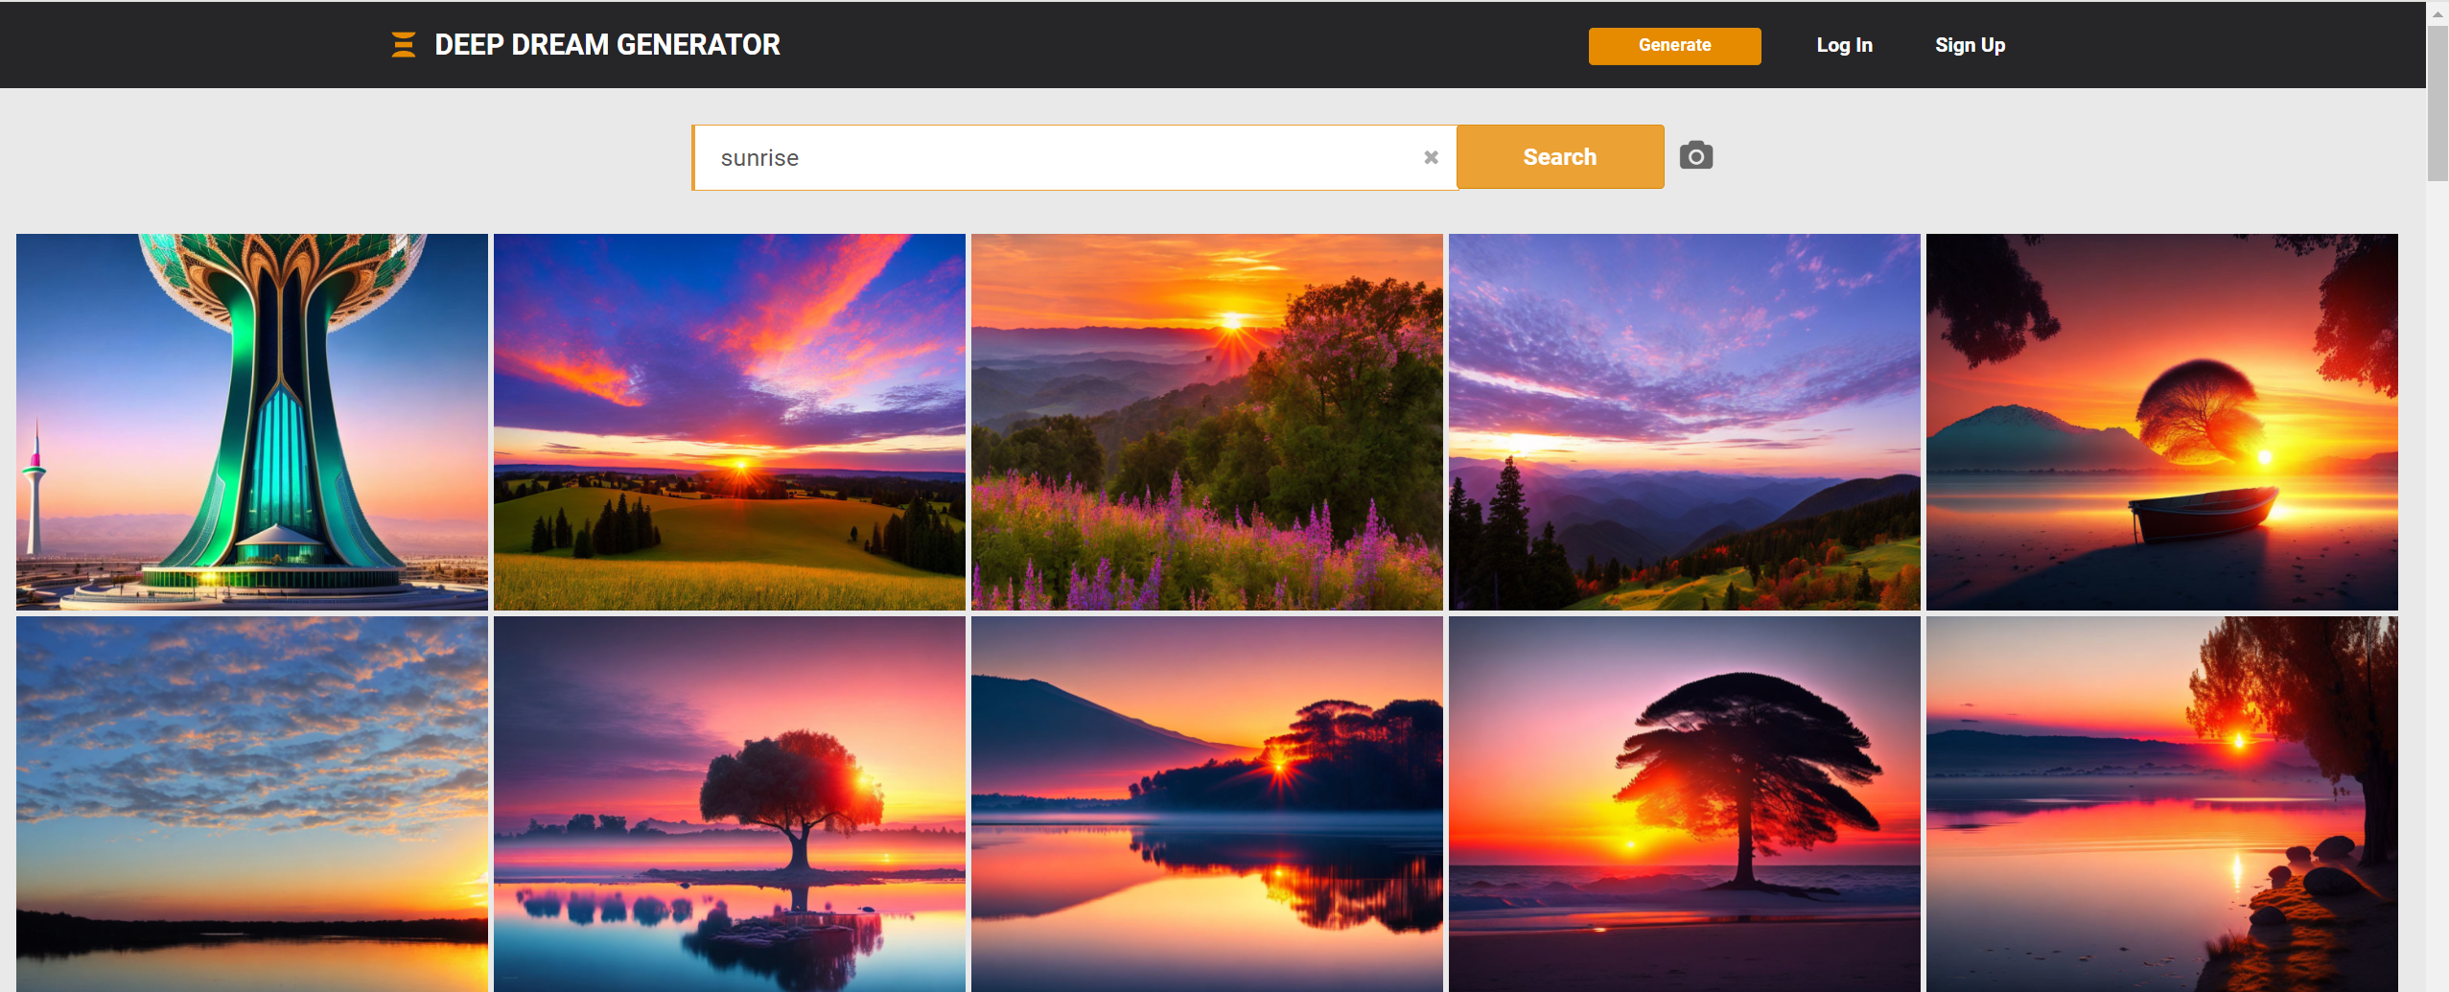
Deep Dream Generator
Transforming Descriptions into Visual Masterpieces
a serene lake surrounded by mountains at sunset

Slide 10


Imagine.art
Sunrise in Paris

Slide 11
AI tools for captioning YouTube videos
AI plays a significant role in this process, in the following ways:
Automatic Speech Recognition (ASR): AI-driven ASR technology is employed to transcribe the spoken words in the video and convert them into text.
Natural Language Processing (NLP): NLP helps in identifying and capturing the nuances of language, improving the accuracy and readability of the captions.
Quality Assurance: AI can be used to review and refine the accuracy of the transcribed text, enhancing the overall quality of the captions

Slide 12
Top Auto-Subtitle Generators
1
6
Maestra
Facebook’s Automatic Caption Feature
2
5
YouTube's Automatic Captions
Kapwing
3
4
Zubtitle
Quicc

Slide 13

One AI tool that can summarize video content
IBM Watson Media offers a feature called “Watson Captioning,” which uses AI-powered speech-to-text technology to automatically transcribe and caption video content. Along with transcription, Watson Captioning can also identify important keywords and topics discussed in the video, allowing users to generate summarized highlights and insights.
The AI technology employed by Watson Captioning enables users to efficiently review and extract key points from video content, facilitating the creation of concise summaries without having to watch an entire video in its entirety. This can be particularly useful for content creators, educators, and researchers who need to process and extract valuable information from video material.

Slide 14

AI Writing Bots: Enhancing Student Skills and Productivity
As students navigate the demands of academia, AI becomes an invaluable companion in refining essential skills. AI bots designed to assist with writing have become invaluable tools for individuals seeking to enhance their writing skills, productivity, and overall communication. These bots leverage artificial intelligence technologies to provide a range of services, from grammar and style corrections to generating creative content

Slide 15


An advanced AI-powered writing assistant designed to enhance the quality and clarity of written communication. It goes beyond conventional grammar and spell-checking, offering a suite of tools to assist users in refining their writing skills.
Reliable spell-checking and grammar-checking
Smooth integration with third-party applications
Highly customizable kinds and levels of correction
Online plagiarism checker finds matches to text available online

Slide 16

Pictory is an AI video software that simplifies the video creation process.
It uses advanced Artificial Intelligence to automatically extract critical points from long-form videos, transform scripts into high-conversion Video Sales Letters, convert blog posts into engaging videos, and even add captions to videos automatically.

Slide 17
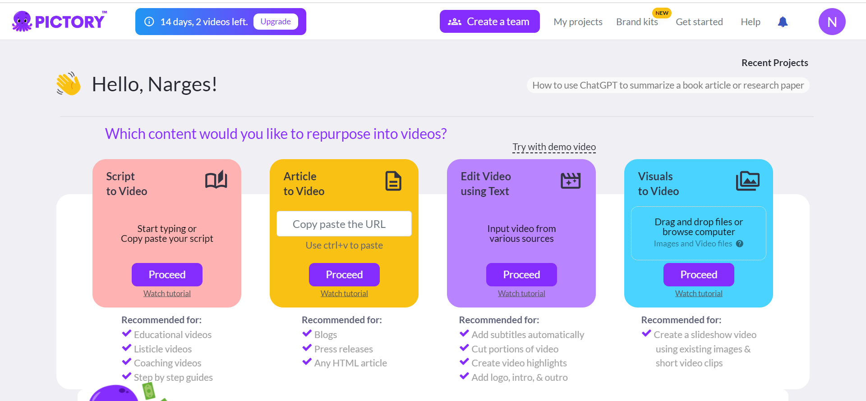
Pictory Homepage

Slide 18

Future of AI in Education
2
Enhanced Virtual Learning Environments
1
Improved Learning Analytics
AI technology will provide more sophisticated data analysis for personalized insights.
AI sites will offer immersive and interactive experiences for remote education.
3
Collaborative Learning with AI
AI-powered platforms will facilitate collaborative learning and knowledge sharing.

Slide 19
conclusion
When it comes to selecting AI tools for learning, there are several factors that should be taken into consideration. It's not just about finding a tool that looks good on the surface, but rather one that truly meets the needs of your school or institution.
For instance AI tools must ensure the security and confidentiality of student data.
In conclusion, choosing the right AI tool for your needs requires careful consideration of compatibility, effectiveness, reliability, and understanding the limitations.
By taking these factors into account, you can make an informed decision that will enhance the learning experience for both students and teachers.

Slide 20
References
"Artificial Intelligence in Education: Promises and Implications for Teaching and Learning" by Rose Luckin
Grammerly.com
Pictory.ai
Imagine.art
ibm.com/watson/media

Slide 21
Thank You for Your Attention

